Slide 1
Homogamy and social structure over time in Finland
Jani Erola and Paul Lambert
Social Stratification Research Seminar, Utrecht, 8-10 September 2010

Slide 2
Aims
Construct CAMSIS scales for Finland
Test the effects of homogamy on partnership matching with the scaling approarch

Slide 3
CAMSIS scale for Finland
Model the social distance between occupational units using average patterns of social interaction/ cohabitation between incumbents of occupations
    www.camsis.stir.ac.uk
    Correspondence analysis for large numbers of units using Stata macro; RC2 association models in R (gnm) for smaller numbers of units for standard errors
Interpret the social distance dimension as indicating the structure of social stratification (the reproduction of social inequality)

Slide 4
Census data inputs
Cohabiting couples, current or previous occupation
  Job coded into 4 digit ISCO
  Plus 2 category employment status
5 yearly and pooled data

Slide 5
Employment status
(self-employed/ employee)

Slide 6
Could ignore this data (noise/inconvenience)
We choose to use it for groups 6-9 only

Slide 7
Occupational units
Occupations were recoded to finest level of detail available (in ISCO-by-employment status location) according to a rule of thumb that at least 30 cases must represent the occupation
Pre-defined recoding rules (use ISCO sub-groups)
 |  | 1970 | 75 | 80 | 85 | 90 | 95 | 2000 | 2005 | all
Number of occs | M | 108 | 129 | 158 | 172 | 183 | 221 | 237 | 248 | 350
 | F | 71 | 91 | 104 | 120 | 135 | 160 | 186 | 208 | 283

Slide 8
Scale derivations using algorithms
Algorithms proceed by:
Define any cohabiting combinations to be excluded from models (ISCO diagonals and farming related pseudo-diagonals – 1311; 6***; 9211)
Recode occupations to avoid sparsity for the remaining cases
Perform CA and extract dimension scores
Standardise scores to mean 50, sd 15
Distribute dimension scores from analytical categories to all ISCO categories according to recoding algorithm

Slide 17
Some further illustrative examples
The role of detailed occupational differences
Illustrative male and female scale values
The problem of farmers

Slide 20
Males: Combined scale (1970-2005)
Male and female CAMSIS scale scores for those ISCO units with over 4000 males in each ISCO

Slide 21
Females: Combined scale (1970-2005)
Male and female CAMSIS scale scores for those ISCO units with over 4000 females in each ISCO
Note how men in female jobs often have higher averages: e.g. 9132 is a ‘average’ job in the male distribution, but is more than 1 SD below average in the female distribution.

Slide 22
i.e. The placement of farmers is influential to the correlation with other things, and is likely to change between scales/time

Slide 23
CAMSIS/ISEI micro comparisons
Education
Income quintiles
Erikson-Goldthorpe classes
Separately for men and women
  Using male scales

Slide 24
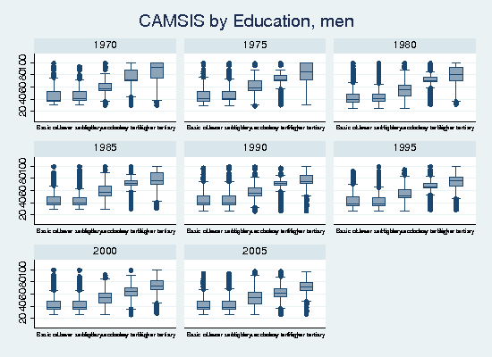
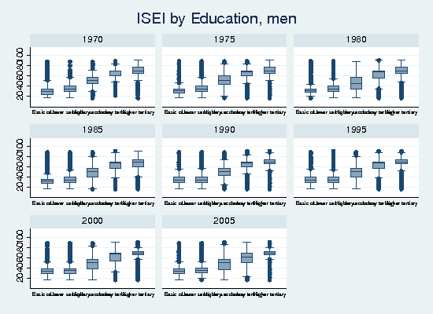
Associations with education, men
R2 | ISEI | FCS
1970 | 44 | 38
1975 | 44 | 42
1980 | 42 | 43
1985 | 47 | 49
1990 | 47 | 50
1995 | 52 | 53
2000 | 47 | 49
2005 | 55 | 48

Slide 25
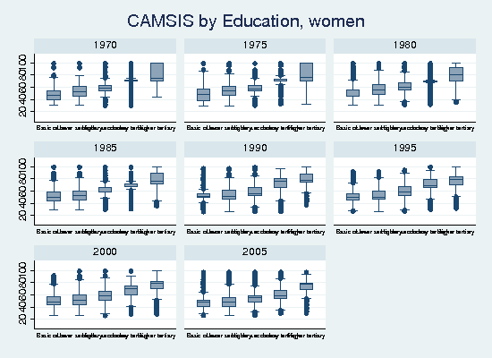
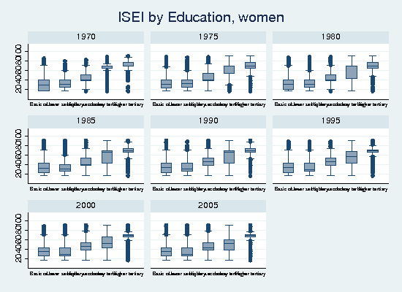
Associations with education, women
R2 | ISEI | FCS
1970 | 31 | 48
1975 | 30 | 49
1980 | 30 | 52
1985 | 33 | 51
1990 | 32 | 51
1995 | 41 | 50
2000 | 38 | 49
2005 | 39 | 47

Slide 26
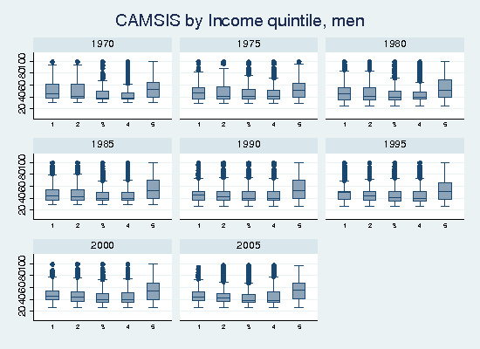
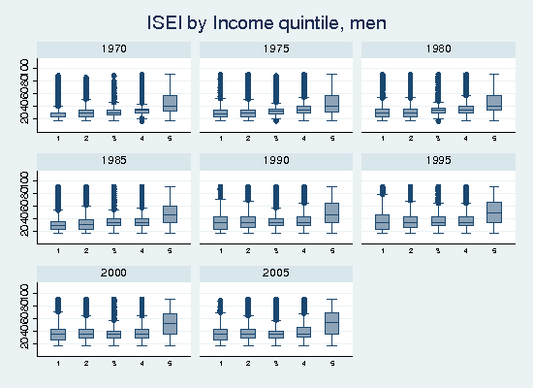
Associations with income, men
R2 | ISEI | FCS
1970 | 23 | 16
1975 | 16 | 13
1980 | 16 | 13
1985 | 16 | 13
1990 | 14 | 13
1995 | 13 | 11
2000 | 15 | 13
2005 | 17 | 16

Slide 27
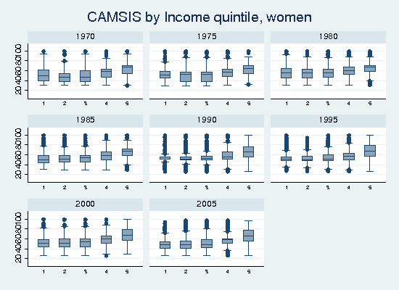
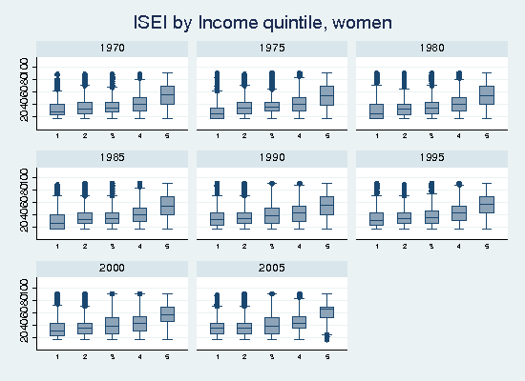
Associations with income, women
R2 | ISEI | FCS
1970 | 20 | 32
1975 | 18 | 24
1980 | 16 | 18
1985 | 18 | 23
1990 | 15 | 21
1995 | 18 | 22
2000 | 19 | 21
2005 | 21 | 24

Slide 28
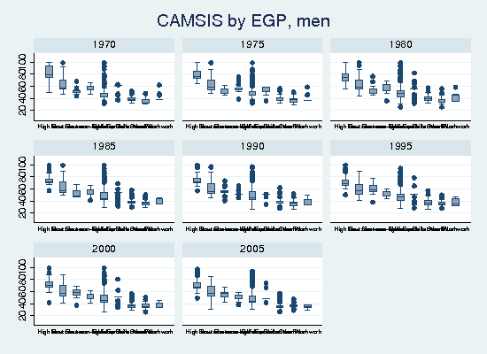
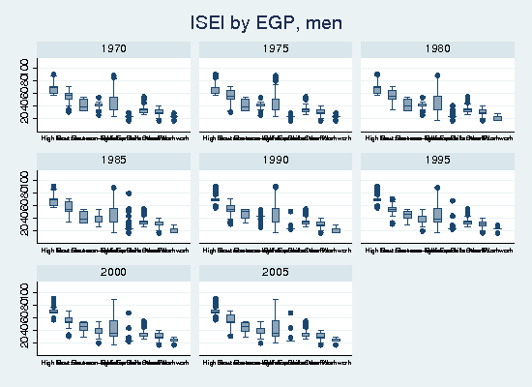
Associations with EGP, men
R2 | ISEI | FCS
1970 | 82 | 70
1975 | 82 | 79
1980 | 80 | 77
1985 | 79 | 75
1990 | 77 | 70
1995 | 77 | 73
2000 | 79 | 74
2005 | 78 | 75

Slide 29
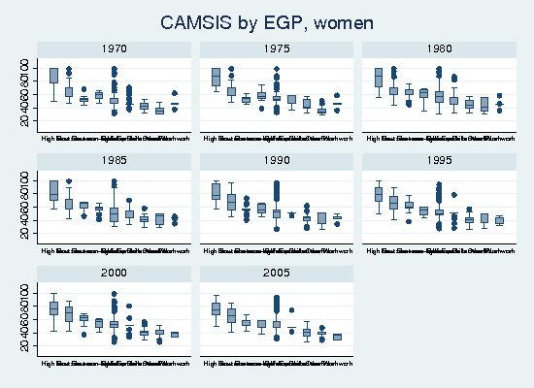
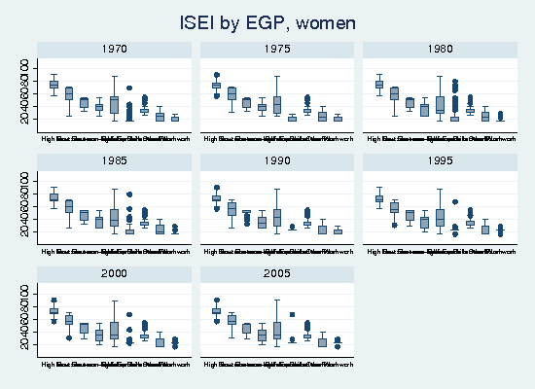
Associations with EG, women
R2 | ISEI | FCS
1970 | 76 | 72
1975 | 76 | 75
1980 | 74 | 77
1985 | 74 | 75
1990 | 71 | 72
1995 | 71 | 71
2000 | 73 | 73
2005 | 73 | 76

Slide 30
Changes in homogamy
Argument: homogamy increasing in most societies
  Kalmijn, 1998; Sweeney & Cancian, 2004; Schwarz & Mare, 2005; Blossfeld, 2009
”Natural” test with couple-data based stratification data
Change in scales = change in the way how couple relationships are stratified
Does changing homogamy play a role in this?

Slide 31
Loglinear RC-models
  RC-coefficients for men and women, changing marginals, diagonal cells controlled
  RC-estimates for men and women, allowing change in diagonals
RC-coefficients assuming no yearly change should be the same as the scale values from CA
The impact of the changes in homogamy should be observed as a change in RC coefficients between the models

Slide 32
Models for ISCO88 Major groups
 | L-squared | df | DI | BIC | AIC
Mod 1. year:men + year:women + Diagonals(men:women) | 48087,6 | 496 | 0,117 | 41540,3 | 47081,6
Mod 2. 1 + RC-association | 3713,9 | 481 | 0,029 | -2638,1 | 2737,9
Mod 3. 2 + Linear change in diagonals | 3015,7 | 473 | 0,025 | -3219,1 | 2057,7
Mod 4. 2 + Non-lin. change in diagonals | 2816,6 | 425 | 0,022 | -2715,3 | 1966,6

Slide 33
The effects of the change in homogamy on RC coefficients
 |  | No change |  | Linear change |  | Non-lin change
 |  | Coeff | SE | Coeff | SE | Coeff | SE
Men | Manag/legis/offic | 0 | 0 | 0 | 0 | 0 | 0
 | Profess | -0,03 | 0,01 | -0,01 | 0,01 | -0,01 | 0,01
 | Tech/Assoc profs | 0,42 | 0,01 | 0,42 | 0,01 | 0,42 | 0,01
 | Clerks | 0,62 | 0,01 | 0,61 | 0,01 | 0,61 | 0,01
 | Service/Sales | 0,59 | 0,01 | 0,59 | 0,01 | 0,59 | 0,01
 | Agriculture | 0,78 | 0,01 | 0,78 | 0,01 | 0,78 | 0,01
 | Crafts/Trades | 1,03 | 0,01 | 1,02 | 0,01 | 1,02 | 0,01
 | Mach operators | 1,09 | 0,01 | 1,08 | 0,01 | 1,08 | 0,01
 | Elementary | 1 | 0 | 1 | 0 | 1 | 0
Women | Manag/legis/offic | 0 | 0 | 0 | 0 | 0 | 0
 | Profess | -0,05 | 0,01 | -0,05 | 0,01 | -0,05 | 0,01
 | Tech/Assoc profs | 0,24 | 0,01 | 0,24 | 0,01 | 0,24 | 0,01
 | Clerks | 0,41 | 0,01 | 0,40 | 0,01 | 0,40 | 0,01
 | Service/Sales | 0,64 | 0,01 | 0,64 | 0,01 | 0,64 | 0,01
 | Agriculture | 0,85 | 0,01 | 0,85 | 0,01 | 0,85 | 0,01
 | Crafts/Trades | 0,83 | 0,01 | 0,83 | 0,01 | 0,83 | 0,01
 | Mach operators | 1,05 | 0,01 | 1,05 | 0,01 | 1,05 | 0,01
 | Elementary | 1 | 0 | 1 | 0 | 1 | 0

Slide 34
Homogamy estimates change to wrong direction!
Homogamy change for…
 | Coef. | SE
Manag/legis/offic | 0,00 | 0,01
Profess | -0,12 | 0,01
Tech/Assoc profs | 0,00 | 0,01
Clerks | 0,02 | 0,01
Service/Sales | 0,00 | 0,01
Crafts/Trades | -0,04 | 0,01
Mach operators | 0,01 | 0,01
Elementary | -0,08 | 0,01

Slide 35
Caveats
Previous results suggest increasing homogamy according to education => occupations different story?
1-digit level simply too coarse?
Now all cohabs, restricting analyses to marriages?

Slide 36
Conclusions
Social interaction distance scales appear to measure stratification quite well on Finnish data
  Differences between men and women
  Main difference between years involves farmers
  Homogamy trends don’t seem to matter
Work very much in beginning…

